Slide 1

AMERICAN INTERNATIONAL UNIVERSITY–BANGLADESH (AIUB)
FACULTY OF SCIENCE & TECHNOLOGY DEPARTMENT OF CS
INTRODUCTION TO DATABASE
FINAL DB PROJECT OF AIUB CRICKET CLUB MANAGEMENT SYSTEM
Submitted by:
No | ID | Name
1 | 21-45077-2 | MD OMAR FARUK SAKIB
2 | 21-44854-2 | ASHFAT AHMED MEDUL
3 | 21-44851-2 | SUMIYA HUR TASNIM
4 | 21-45081-2 | MD. ABU HOJIFA
Submitted to:
Name: Dr. S.M. HASAN Mahmud
Date of Submission: April 20,2022
Page 1 of 35

Slide 2
TABLE OF CONTENTS
TOPICS | Page no.
1. Cover Page | 1
2. Table of Contents | 2
3. Project Description | 3
4. ER Diagram | 4
5. Case Study | 5
6. Normalization | 6
7. Table Creation | 14
8. Data Insertion | 23
9. View | 30
10. Sequence | 32
11. Conclusion | 33
Page 1 of 35

Slide 3
Project Description Of
AIUB Cricket Club Management System
This project is all about AIUB cricket club management system. This project stands on database. In our real life, there have occurs a lot of cricket tournaments in many countries. So, in those games many teams are participated. In this case, it is important to manage all the data of the clubs. For this case we make a project to manage the data of all clubs in AIUB. This project has many efficient features by which people can easily use those data. In every case of cricket club management people need the player’s name, club name, player details, club details, coach details, the statistic of their previous played match, their financials etc. All those features are added in this project work. By this a person can do all kind of operation for their data. All this we can say that it is a complete package of data about AIUB cricket club management system and people can see or find any kind of data from this project of database.
Page 1 of 35

Slide 4
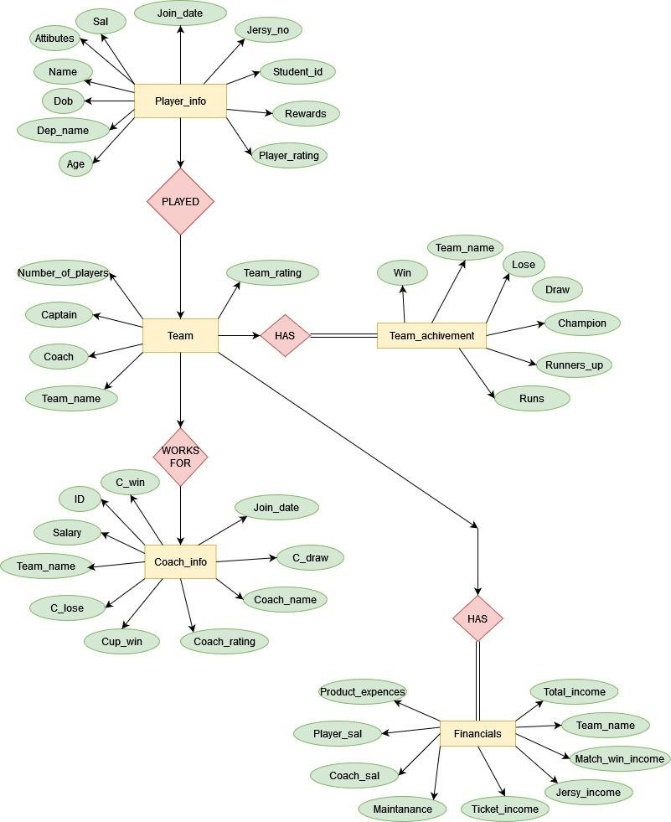
E-R Diagram Of
AIUB Cricket Club Management System
Page 1 of 35

Slide 5
Case Study Of
AIUB Cricket Club Management System
In this project we design an e-r diagram to make a map of our project. This e-r diagram mainly helps us to create the tables, make the relations, normalization and so on. In this case we can see in the e-r diagram that there have five entities and each entity have a lot of attributes. Diamond shapes are used for relation.
Team entity has relation with player_info, financial, coach_info and achievement. There have “many to many” relation. In player_info p.id is the primary keyword and jersy number in multivalued attribute also age is derived attribute and rest of all are normal attribute. They are player name, p.sal, DOB, age, Team_name, jersy no, attributes, rewards, rating. Team_name is a foreign key of player_info table.
Then comes team entity. It has team_name as a primary key and rest all of the attributes are normal attributes. Those are coach_name, Num_of_players, Team_rating, captain. Also, we have financial, coach_info and team_acheivement entities where have also the same primary key attributes. Coach_infohave coach_name,join date,c.win,c.lose,c.draw,c.sal,c.rating attributes. Financial has maintanence, jersy income, sal, match_win_income, ticket_income, production_expences, total_income attributes. The last entity achievement has win, lose, draw, runners-up, champion, Runs, attributes. Now comes the matter of of normalization. In this case we see that only team and player info relational
table have 1 NF. All other doesn’t have 1NF. We also normalize team and financial, team and coach, team and achievement relational table. We found that we need to do 2NF in all relational table but we need to do 3NF in only two matter. Those are team and player_info, team and financials. Then we create table after normalization and insert our data and do our rest operations.
Page 1 of 35

Slide 6
ANIK | SAIF | ANIK | P.NAME
CS | EEE | CS | DEP- NAME
101 | 102 | 101 | STUDENT- ID
BOWLER | Keeper Batsman | BATSMAN | Attributes
20-1-1999 | 21-1-2000 | 20-1-1999 | DOB
23 | 22 | 23 | AGE
20-`1- 2005 | 20-1-2006 | 20-`1- 2005 | JOIN- DATE
75 | 15 | 75 | JERSY_ NUM
10000 | 80000 | 10000 | P.SAL
7 | 5 | 7 | MOT
5 | 5 | 5 | PLAYERRA TING
ANIK | ALMAS | ANIK | CAPTAIN
HATURA | STRICT | HATURA | COACH
26 | 27 | 26 | NUM_OF _PLAYERS
5 | 5 | 5 | T. RATING
SAIF | ANIK | P.NAME
EEE | CS | DEP- NAME
102 | 101 | STUDENT -ID
Keeper Batsman | BOWLER BATSMAN | Attribute s
21-1- 2000 | 20-1- 1999 | DOB
22 | 23 | AGE
20-1- 2006 | 20-1- 2005 | JOIN_DA TE
15 | 75 | JERSY_ NUM
80000 | 10000 | P.SAL
5 | 7 | MOT
5 | 5 | P. RATING
ALMAS | ANIK | CAPTAIN
STRICT | HATURA | COACH
27 | 26 | NUM_OF _PLAYERS
5 | 5 | T. RATING
Final Project
TEAM and PLAYER INFO AFTER 1NF
Normalization
TEAM and PLAYER INFO
Page 6 of 35

Slide 7
TEAM and PLAYER INFO AFTER 2NF
P.NAM E | STUDEN T.ID | Attri butes | AGE | JOIN_D ATE | JERSY_ NUM | P.SAL | MOT | P. RATING | DOB
ANIK | 101 | BATS MAN | 23 | 20-`1- 2005 | 75 | 10000 | 7 | 5 | 20-1-1999
SAIF | 102 | Keep er Bats man | 22 | 20-1- 2006 | 15 | 80000 | 5 | 5 | 21-1-2000
ANIK | 101 | BOWL ER | 23 | 20-`1- 2005 | 75 | 10000 | 7 | 5 | 20-1-1999
DEP.NAME | CAPTAIN | COACH_NAME | NUM_OF_PLAYERS | T. RATING
CS | ANIK | HATURA | 26 | 5
EEE | SAIF | STRICT | 27 | 5
CS | ANIK | HATURA | 26 | 5
DEP.NAME | STUDENT.ID
CS | 101
EEE | 102

Slide 8
AFTER 3 NF
PLAYER_INFO Table:
P.NAME | STUDE NT.ID | Attributes | AGE | JOIN_DATE | JERSY_ NUM | P.SAL | MOT | P. RATING
ANIK | 101 | BATSMAN | 35 | 20-`1-2005 | 30 | 10000 | 7 | 5
SAIF | 102 | Keeper Batsman | 37 | 20-1-2006 | 7 | 80000 | 5 | 5
ANIK | 101 | BOWLER | 35 | 20-`1-2005 | 10 | 10000 | 7 | 5
Player_DOB:
Player_Id | Dob | Age
101 | 20-1-1986 | 35
102 | 21-1-1984 | 37
TEAM AND COACH INFO
TEAM NAME | COACH_ NAME | NUM_OF _PLAYER | CAPTAIN | TEAM_R ATING | COACH_R ATING | C.SAL | JOIN_DA TE | CUP_WIN | C.WIN | C.LOSE | C.DRAW | COACH_I D
CS | HATURA | 26 | ANIK | 5 | 4 | 85000 | 20-3- 2019 | 1 | 20 | 20 | 17 | 1001
EEE | STRICT | 24 | SAIF | 5 | 5 | 70000 | 20-1- 2017 | 3 | 57 | 29 | 20 | 1002
1NF: TEAM AND COACH INFO TABLE IS ALREADY IN 1NF BECAUSE TO DO 1NF THERE HAVE TO BE MULTIVALUE BUT AS THERE IS NO MULTIVALUE SO WE DON’T HAVE TO DO 1NF(FIRST NORMAL FORM)

Slide 9
TEAM AND COACH INFO TABLE AFTER 2NF
DEP _NAME | COACH_NAME | NUM_OF_PLAYER | CAPTAIN | TEAM_RATING
CS | HATURA | 26 | Shakib | 5
EEE | STRICT | 24 | Mushfiq | 5
DEP_NA ME | COACH_N AME | COACH_RAT ING | C.SA L | JOIN_D ATE | CUP_W IN | C.WI N | C.LO SE | C.DRA W | COACH _ID
CS | HATURA | 4 | 850 00 | 20-3- 2019 | 1 | 20 | 20 | 17 | 1001
EEE | STRICT | 5 | 700 00 | 20-1- 2017 | 3 | 57 | 29 | 20 | 1002
COACH_ID | DEP_NAME
1001 | CS
1002 | EEE
3NF: IN THIS TABLE THERE IS NO NEED TO DO 3NF BECAUSE NO NON- PRIMARY KEY ATTRIBUTE IS TRANSITIVELY DEPENDENT ON PRIMARY KEY.

Slide 10
TEAM AND FINANCIALS INFO
DEP_NAME | COACH_NAME | NUM_OF_PLAYER | CAPTAIN | TEAM_RATING | MAINTANANCE | COACH_SAL | TICKET-INCOME | PLAYER_SAL | JERSY_INCOME | MATCH_INCOME | PRODUCTION_EX PENCES | TOTAL_INCOME
CS | HATURA | 26 | ANIK | 5 | 400000 | 85000 | 300000 | 150000 | 230000 | 400045 | 3548684O4 | 66554456
EEE | STRICT | 24 | SAIF | 5 | 500000 | 10000 | 29000000 | 140000 | 2389464 | 39754 | 58494944 | 46655446
1NF: TEAM AND FINANCIALS INFO TABLE IS ALREADY IN 1NF BECAUSE TO DO 1NF THERE HAVE TO BE MULTIVALUE BUT AS THERE IS NO MULTIVALUE SO WE DON’T HAVE TO DO 1NF(FIRST NORMAL FORM)
After 2nf:
DEP_NAME | COACH_NAME | NUM_OF_PLAYER | CAPTAIN | TEAM_RATING
CS | HATURA | 26 | ANIK | 5
EEE | STRICT | 24 | SAIF | 5

Slide 11
DEP_NAME | MAINTANANCE | COACH_SAL | TICKET-INCOME | PLAYER_SAL | JERSY_INCOME | MATCH_INCOME | PRODUCTION_EXPE NCES | TOTAL_INCOME
CS | 400000 | 90000 | 300000 | 1500000 | 40000 | 400045 | 684O4 | 655456
EEE | 500000 | 10000 | 51000 | 140000 | 39500 | 386754 | 594944 | 455446
AFTER 3NF:
TEAM_NAME | MAINTANANCE | COACH_SAL | TICKET-INCOME | PLAYER_SAL | JERSY_INCOME | MATCH_INCOME | PRODUCTION_EXPENCE S
CS | 400000 | 9000000 | 30000000 | 150000000 | 40000000 | 40000045 | 3548684O4
EEE | 500000 | 1000000 | 29000000 | 140000000 | 39500000 | 39086754 | 58494944

Slide 12
TEAM_NAME | TOTAL_INCOME
CS | 655456
EEE | 455446
TEAM AND ACHIEVEMENT
DEP_NAME | COACH_NAME | NUM_OF_PLAY ER | CAPTAIN | TEAM_RATING | Runs | WIN | LOSE | DRAW | RUNNING_UP | CHAMPION
CS | HATURA | 26 | ANIK | 5 | 5000 | 700 | 400 | 250 | 20 | 7
EEE | STRICT | 24 | SAIF | 5 | 4789 | 702 | 350 | 250 | 15 | 6
1NF: TEAM AND ACHIEVEMENT INFO TABLE IS ALREADY IN 1NF BECAUSE TO DO 1NF THERE HAVE TO BE MULTIVALUE BUT AS THERE IS NO MULTIVALUE SO WE DON’T HAVE TO DO 1NF(FIRST NORMAL FORM)

Slide 13
AFTER 2NF:
DEP_NAME | COACH_NAME | NUM_OF_PLAYER | CAPTAIN | TEAM_RATING
CS | HATURA | 26 | ANIK | 5
EEE | STRICT | 24 | SAIF | 5
DEP_NAME | Runs | WIN | LOSE | DRAW | RUNNING_UP | CHAMPION
CS | 5000 | 700 | 400 | 250 | 20 | 7
EEE | 4789 | 702 | 350 | 250 | 15 | 6
3NF: IN THIS TABLE THERE IS NO NEED TO DO 3NF(THIRD NORMAL FORM) BECAUSE NO NON- PRIMARY KEY ATTRIBUTE IS TRANSITIVELY DEPENDENT ON PRIMARY KEY.

Slide 14
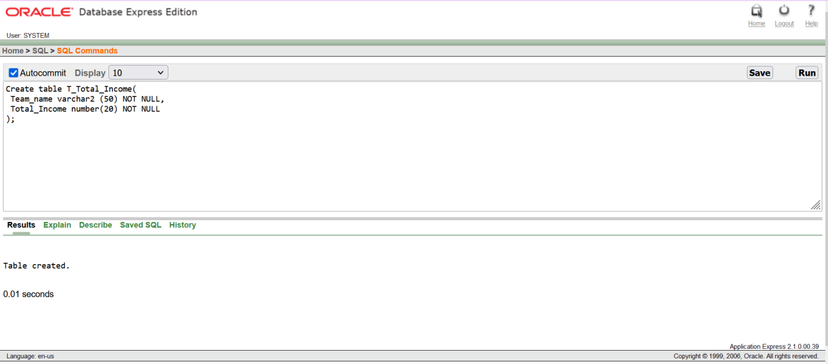
Table Creation
1. Create table T_Total_Income( Team_name varchar2 (50) NOT NULL, Total_Income number(20) NOT NULL
);
2. Create table T_Financial_info(
Team_name varchar2(50) NOT NULL, Ticket_income number (20) NOT NULL, Jercy_income number(20) NOT NULL, Match_Winning_income number(20) NOT NULL, Coach_Sal number(20) NOT NULL,
Player_Sal number(20) NOT NULL,
Production_expense number(20) NOT NULL, Material number(20) NOT NULL
);

Slide 15
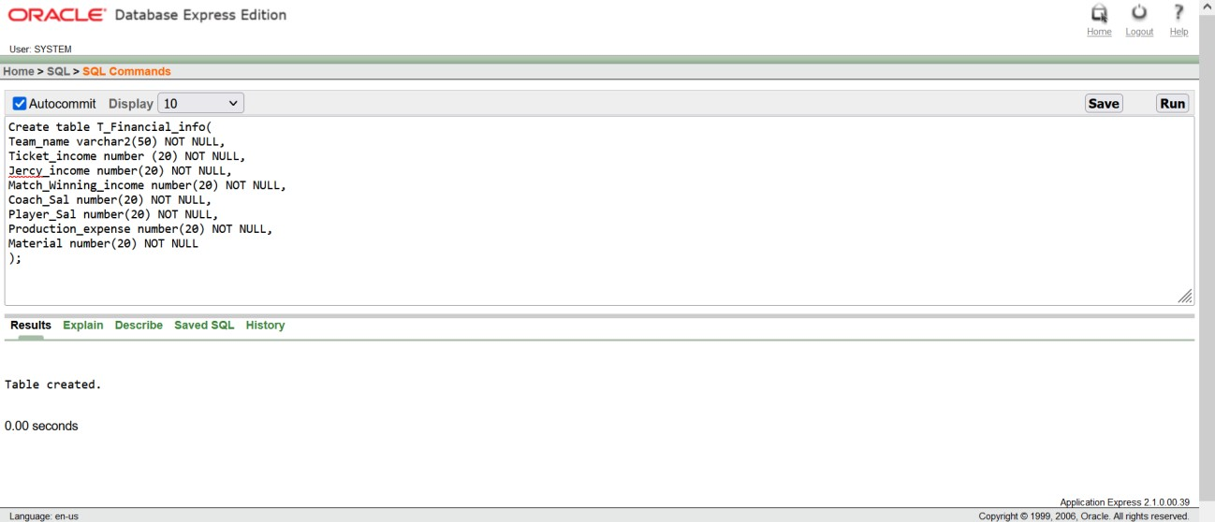
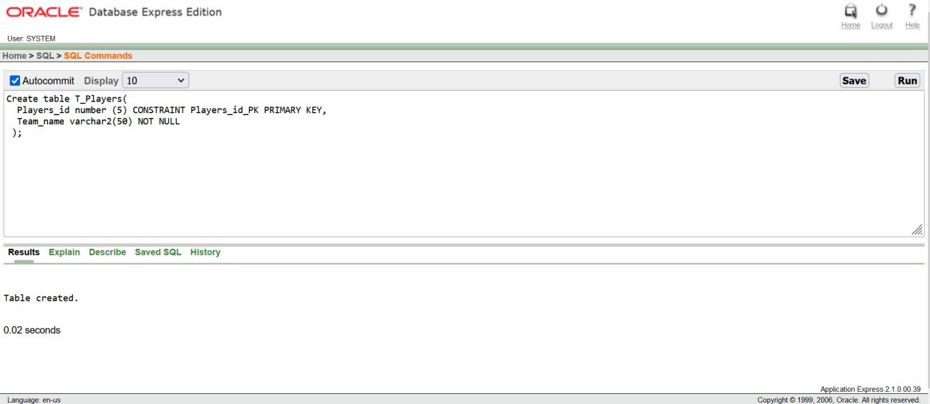
3. Create table T_Players(
Players_id number (5) CONSTRAINT Players_id_PK PRIMARY KEY, Team_name varchar2(50) NOT NULL
);

Slide 16
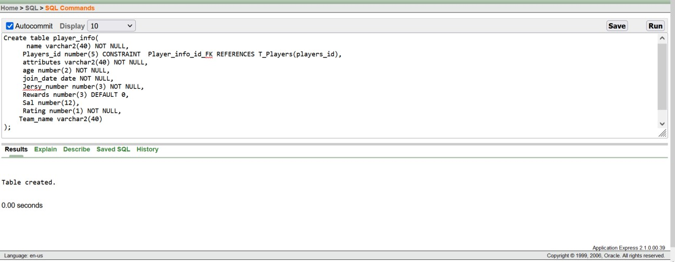
4. Create table player_info(
name varchar2(40) NOT NULL,
Players_id number(5) CONSTRAINT Player_info_id_FK REFERENCES T_Players(players_id),
attributes varchar2(40) NOT NULL, age number(2) NOT NULL, join_date date NOT NULL,
Jersy_number number(3) NOT NULL, Rewards number(3) DEFAULT 0,
Sal number(12),
Rating number(1) NOT NULL, Team_name varchar2(40)
);

Slide 17
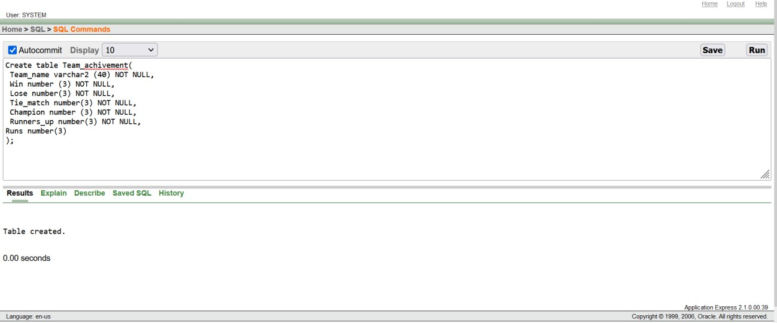
5. Create table Team_achivement(
Team_name varchar2 (40) NOT NULL, Win number (3) NOT NULL,
Lose number(3) NOT NULL,
Tie_match number(3) NOT NULL, Champion number (3) NOT NULL, Runners_up number(3) NOT NULL, Runs number(3)
);

Slide 18
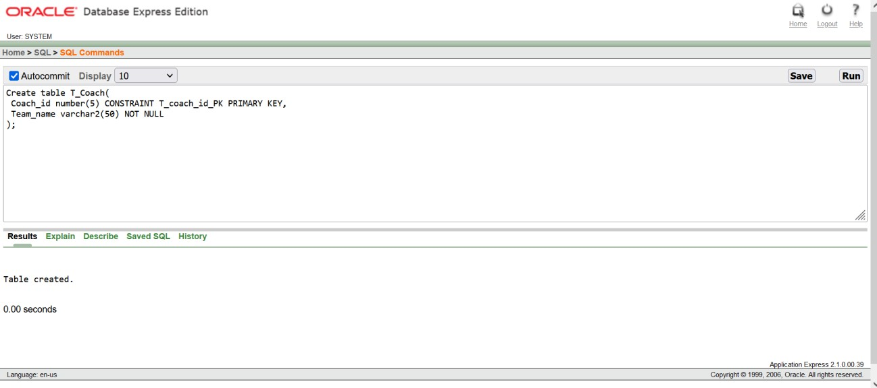
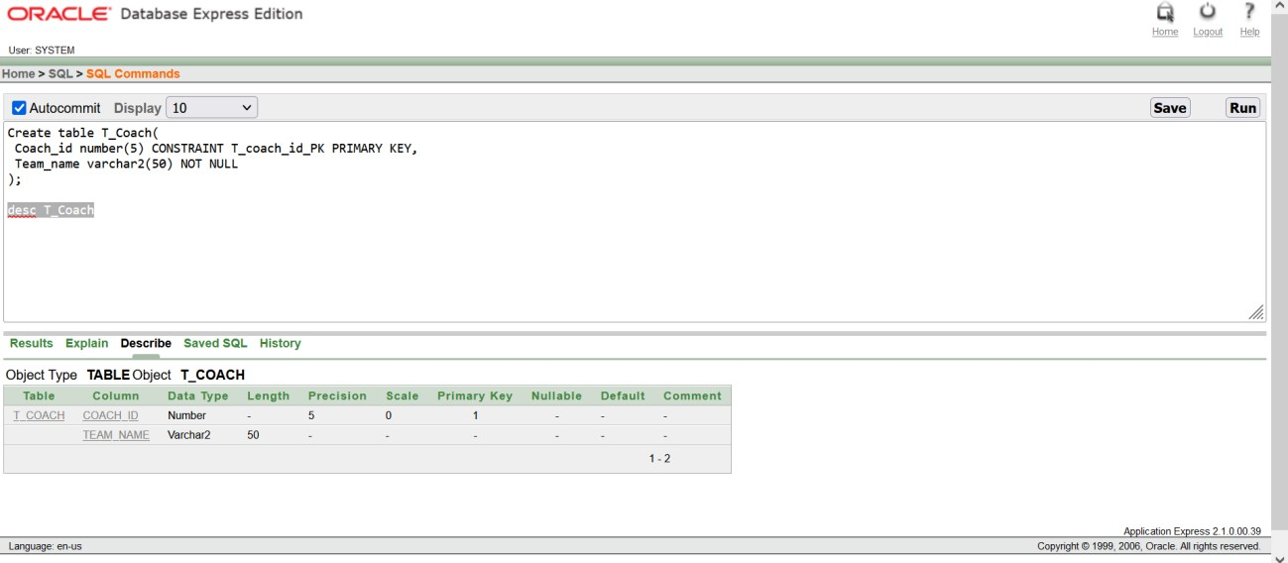
6. Create table T_Coach(
Coach_id number(5) CONSTRAINT T_coach_id_PK PRIMARY KEY, Team_name varchar2(50) NOT NULL
);

Slide 19
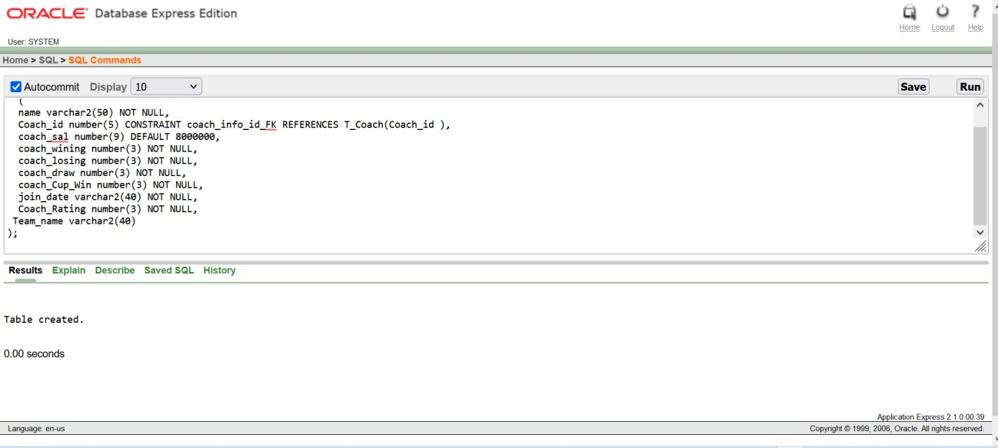
7. Create table coach_info
(
name varchar2(50) NOT NULL,
Coach_id number(5) CONSTRAINT coach_info_id_FK REFERENCES T_Coach(Coach_id ), coach_sal number(9) DEFAULT 8000000,
coach_wining number(3) NOT NULL, coach_losing number(3) NOT NULL, coach_draw number(3) NOT NULL, coach_Cup_Win number(3) NOT NULL, join_date varchar2(40) NOT NULL, Coach_Rating number(3) NOT NULL, Team_name varchar2(40)
);

Slide 20
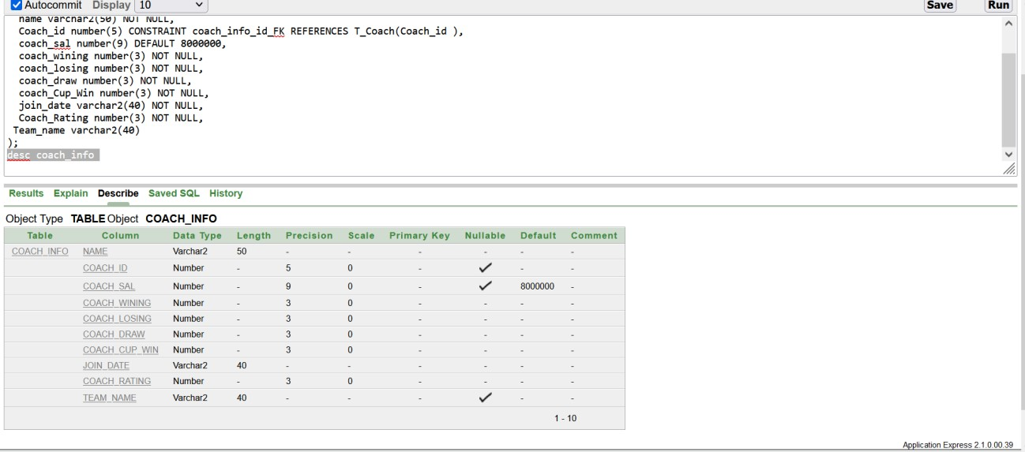
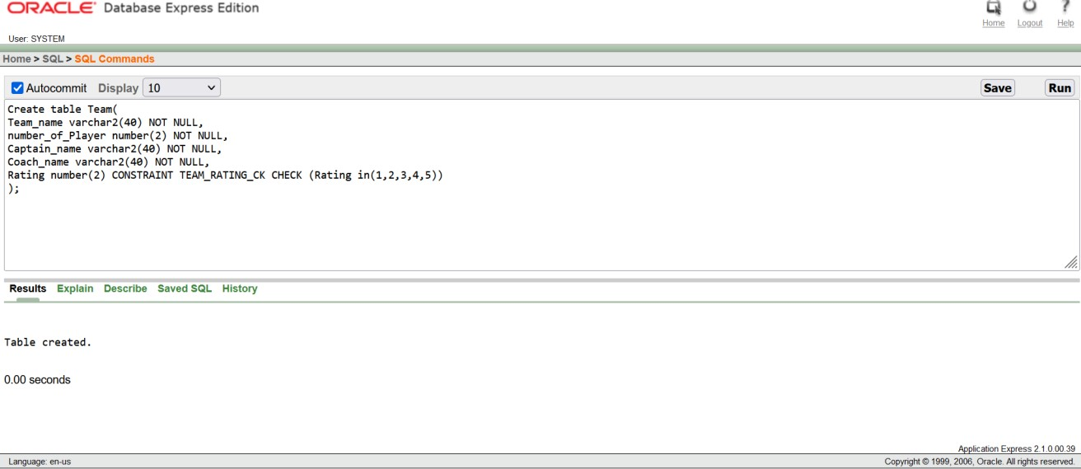
8. Create table Team(
Team_name varchar2(40) NOT NULL, number_of_Player number(2) NOT NULL, Captain_name varchar2(40) NOT NULL, Coach_name varchar2(40) NOT NULL,
Rating number(2) CONSTRAINT TEAM_RATING_CK CHECK (Rating in(1,2,3,4,5))
);

Slide 21
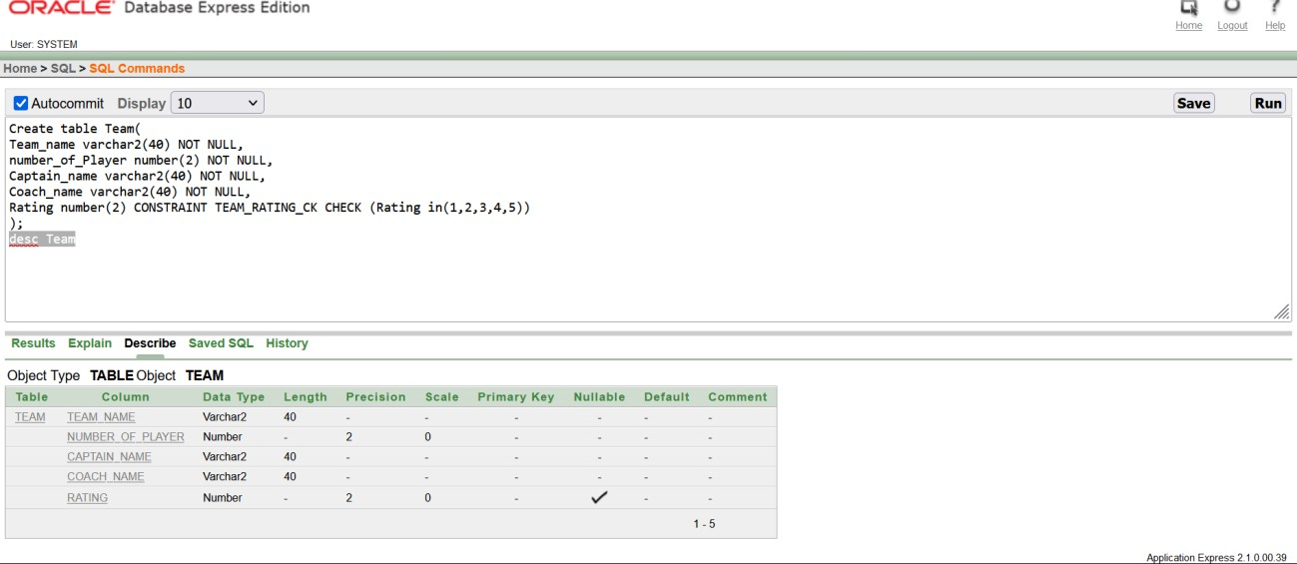
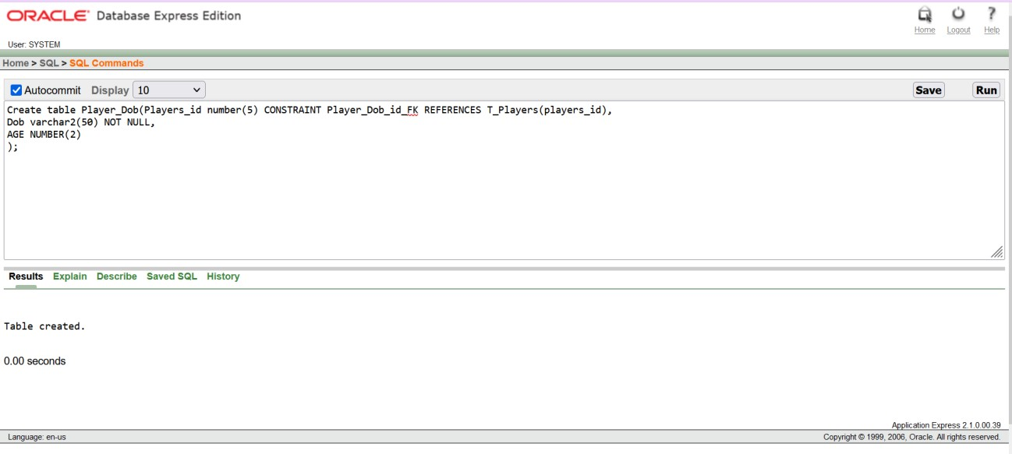
9. Create table Player_Dob(Players_id number(5) CONSTRAINT Player_Dob_id_FK REFERENCES T_Players(players_id),
Dob varchar2(50) NOT NULL, AGE NUMBER(2)
);

Slide 22
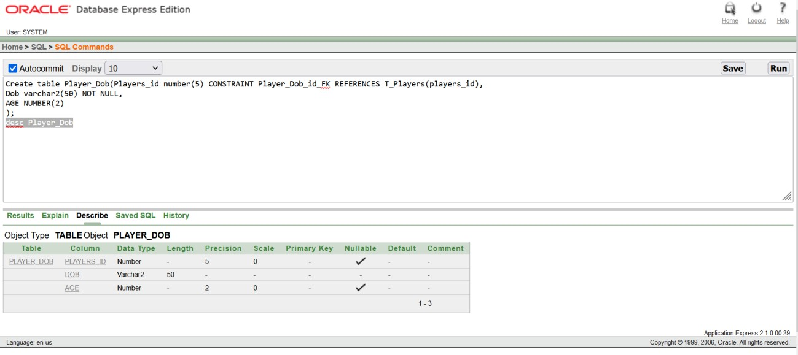
NOTE: In this project we used constraint. There are 6 constraint we learned from the beginning of the course. Here we have used PRIMARY KEY CONSTRAINT, FOREIGN KEY CONSTRAINT, DEFAULT, NOT NULL and CHECK.
We used default in Reward as 0 and Coach salary as 8000000. Which means if we don’t add or insert any value in Reward and Coach salary by default oracle show you the value 0 at reward and 8000000 at coach salary.
And we have add here the check constraint in team rating. It is a logical constraint and we give logic here, rating from 1 to 5.
So, when we would be inserting value in rating we have to give value from 1 to 5.

Slide 23
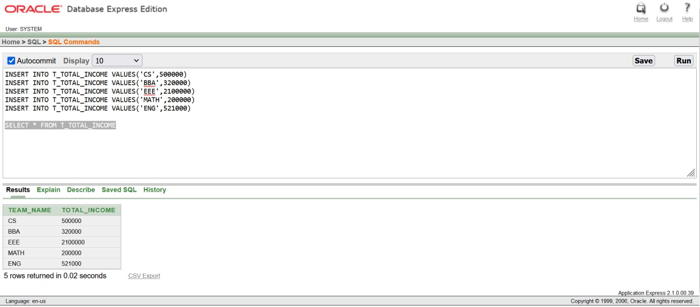
INSERTATION
1. INSERT INTO T_TOTAL_INCOME VALUES('CS',500000)
INSERT INTO T_TOTAL_INCOME VALUES('BBA',320000) INSERT INTO T_TOTAL_INCOME VALUES('EEE',2100000) INSERT INTO T_TOTAL_INCOME VALUES('MATH',200000) INSERT INTO T_TOTAL_INCOME VALUES('ENG',521000) SELECT * FROM T_TOTAL_INCOME
2. INSERT INTO T_FINANCIAL_INFO VALUES('CS',300000,2580000,100000,100000,1500000,200000,50000)
INSERT INTO T_FINANCIAL_INFO VALUES('BBA',280000,2200000,103000,110000,1200000,190000,43000)
INSERT INTO T_FINANCIAL_INFO VALUES('EEE',220000,150000,70000,80000,100000,150000,40000)
INSERT INTO T_FINANCIAL_INFO VALUES('MATH',250000,160000,75000,90000,110000,170000,40000)
INSERT INTO T_FINANCIAL_INFO VALUES('ENG',260000,200000,99500,100000,150000,190000,48000)

Slide 24
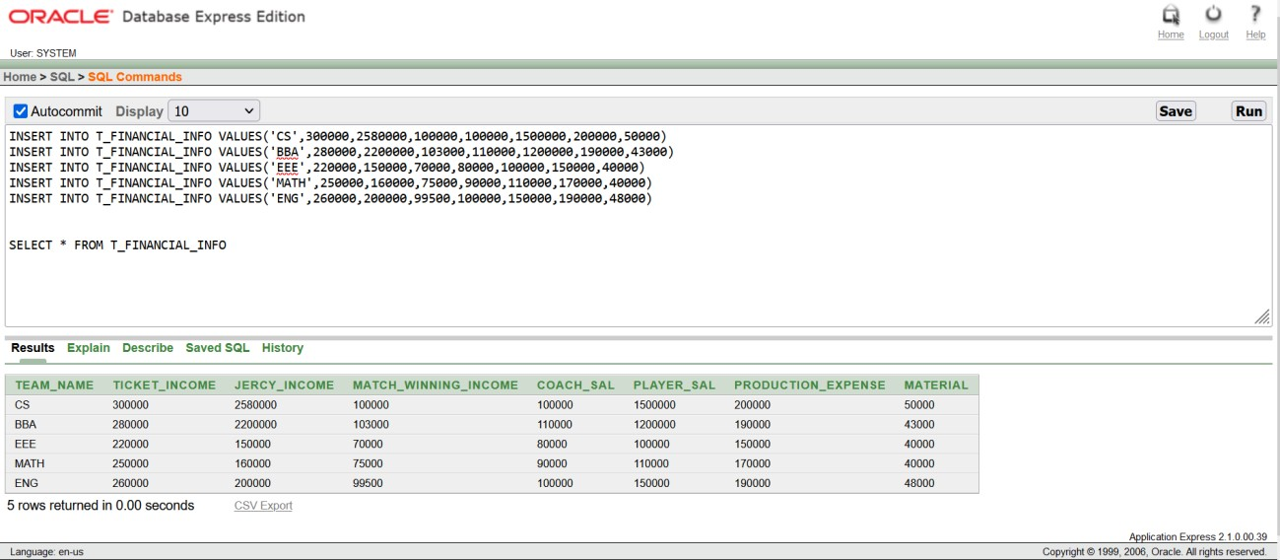
SELECT * FROM T_FINANCIAL_INFO
3. INSERT INTO T_PLAYERS VALUES(101,'CS')
INSERT INTO T_PLAYERS VALUES(102,'BBA')
INSERT INTO T_PLAYERS VALUES(103,'ENG') INSERT INTO T_PLAYERS VALUES(104,'ENG') INSERT INTO T_PLAYERS VALUES(105,'CS') INSERT INTO T_PLAYERS VALUES(106,'MATH') INSERT INTO T_PLAYERS VALUES(107,'EEE') INSERT INTO T_PLAYERS VALUES(108,'EEE') INSERT INTO T_PLAYERS VALUES(109,'CS') INSERT INTO T_PLAYERS VALUES(110,'BBA') SELECT * FROM T_PLAYERS

Slide 25
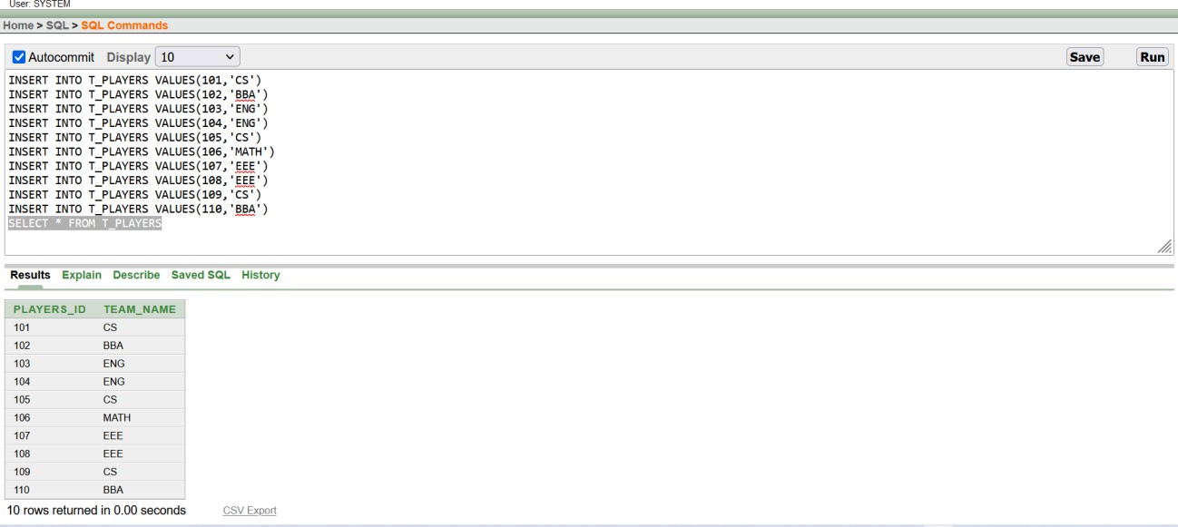
4.
INSERT INTO PLAYER_INFO VALUES('ANIK',101,'Allrounder',35,'20-01- 2005',10,7,100000,5,'CS')
INSERT INTO PLAYER_INFO VALUES('SAIF',102,'Keeper',37,'20-01-2006',7,5,99000,5,'BBA')
INSERT INTO PLAYER_INFO VALUES('ANIK',101,'Allrounder',35,'20-01- 2005',30,7,100000,5,'CS')
INSERT INTO PLAYER_INFO VALUES('ANIK',103,'Allrounder',35,'20-01- 2005',7,7,1000000,5,'CS')
INSERT INTO PLAYER_INFO VALUES('ANINDYA',104,'Allrounder',25,'20-01- 2015',30,7,80000,5,'ENG');
INSERT INTO PLAYER_INFO VALUES('SOURAV',105,'Keeper',34,'29-09- 2012',11,6,70000,5,'ENG');
INSERT INTO PLAYER_INFO VALUES('ALMAS',106,'Bowler',35,'20-01-2013',8,6,80000,5,'CS');
INSERT INTO PLAYER_INFO VALUES('KAIF',107,'Openner',27,'21-09- 2011',1,6,60000,5,'MATH');
INSERT INTO PLAYER_INFO VALUES('IQBAL',108,'Batsman',30,'29-05- 2015',17,4,50000,4,'EEE');
INSERT INTO PLAYER_INFO VALUES('ABIR',109,'Batsman',25,'15-03- 2014',10,2,40000,4,'EEE');
SELECT * FROM PLAYER_INFO

Slide 26
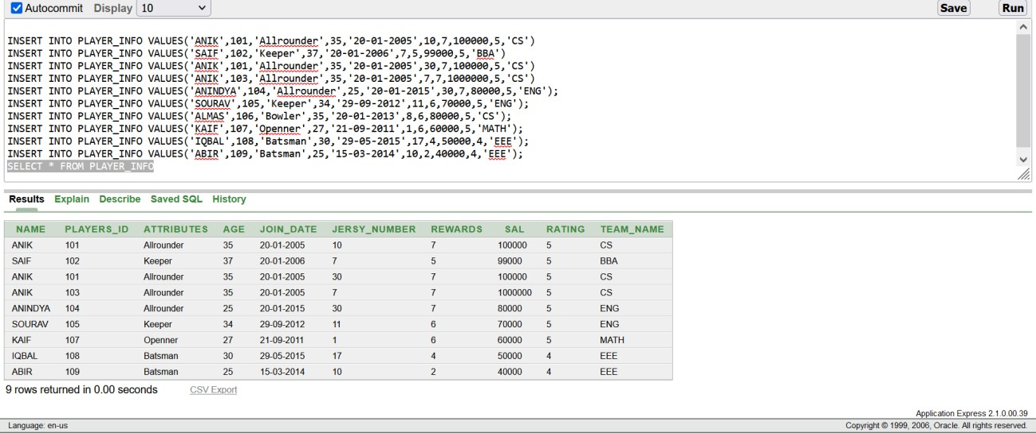
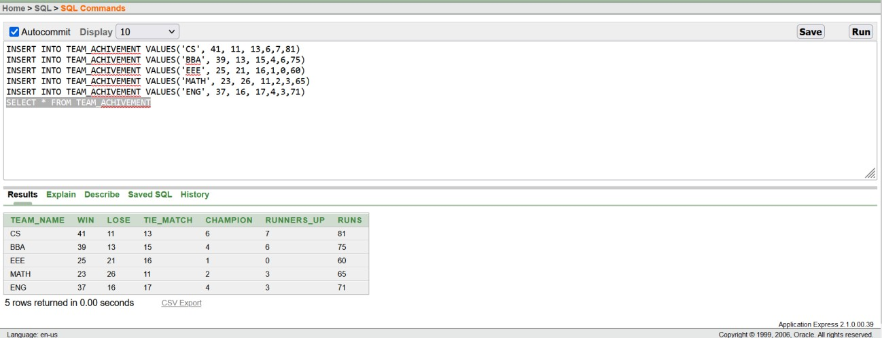
5. INSERT INTO TEAM_ACHIVEMENT VALUES('CS', 41, 11, 13,6,7,81)
INSERT INTO TEAM_ACHIVEMENT VALUES('BBA', 39, 13, 15,4,6,75)
INSERT INTO TEAM_ACHIVEMENT VALUES('EEE', 25, 21, 16,1,0,60)
INSERT INTO TEAM_ACHIVEMENT VALUES('MATH', 23, 26, 11,2,3,65)
INSERT INTO TEAM_ACHIVEMENT VALUES('ENG', 37, 16, 17,4,3,71) SELECT * FROM TEAM_ACHIVEMENT

Slide 27
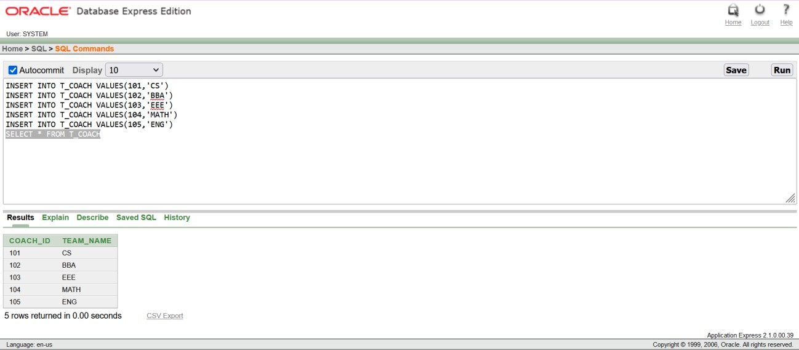
6. INSERT INTO T_COACH VALUES(101,'CS')
INSERT INTO T_COACH VALUES(102,'BBA')
INSERT INTO T_COACH VALUES(103,'EEE') INSERT INTO T_COACH VALUES(104,'MATH') INSERT INTO T_COACH VALUES(105,'ENG') SELECT * FROM T_COACH
7. INSERT INTO COACH_INFO VALUES('Hatura',101,10000000,41,11,13,6,'05-02-
2019',89,'CS')
INSERT INTO COACH_INFO VALUES('Strict',102,11000000,39,13,15,4,'05-07-2018',92,'BBA') INSERT INTO COACH_INFO VALUES('Vettory',103,8000000,25,21,16,1,'06-03-2019',85,'EEE')
INSERT INTO COACH_INFO VALUES('Domingo',104,9000000,23,26,11,2,'08-05- 2019',87,'MATH')
INSERT INTO COACH_INFO VALUES('Rhodes',105,10000000,37,16,17,4,'07-04-2018',89,'ENG') SELECT * FROM COACH_INFO

Slide 28
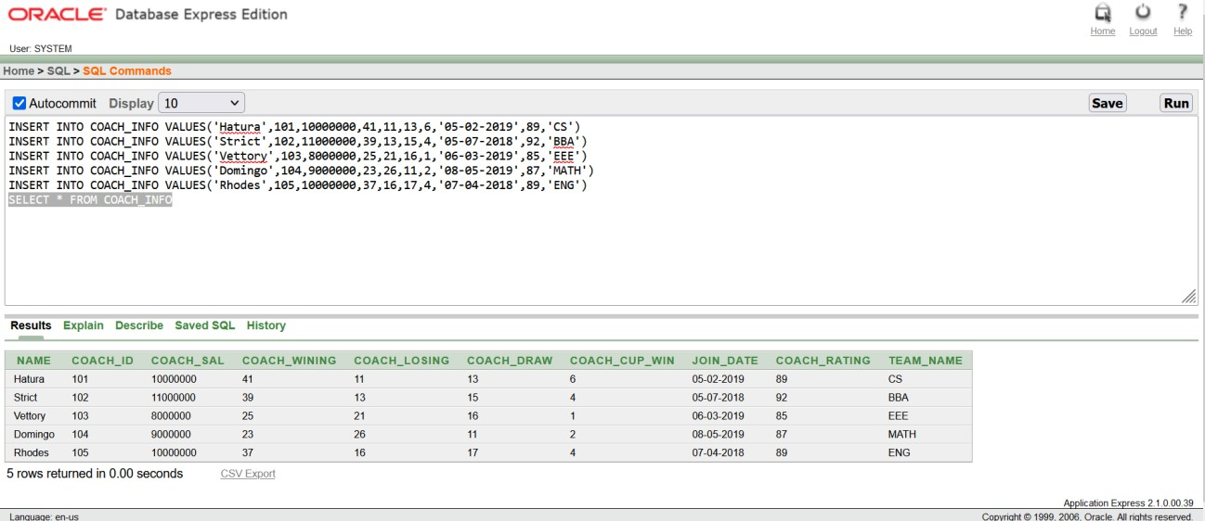
8.
INSERT INTO TEAM VALUES ('CS', 24, 'ANIK', 'JAYED', 5 )
INSERT INTO TEAM VALUES ('BBA', 23, 'Sami', 'SAKIB', 5 ) INSERT INTO TEAM VALUES ('EEE', 24, 'IQBAL', 'AZIZ', 4.5 ) INSERT INTO TEAM VALUES ('MATH', 23, 'KAIF', 'MRIDUL', 4.5 ) INSERT INTO TEAM VALUES ('ENG', 23, 'Taijul', 'MEHEDI', 5 ) SELECT * FROM TEAM

Slide 29
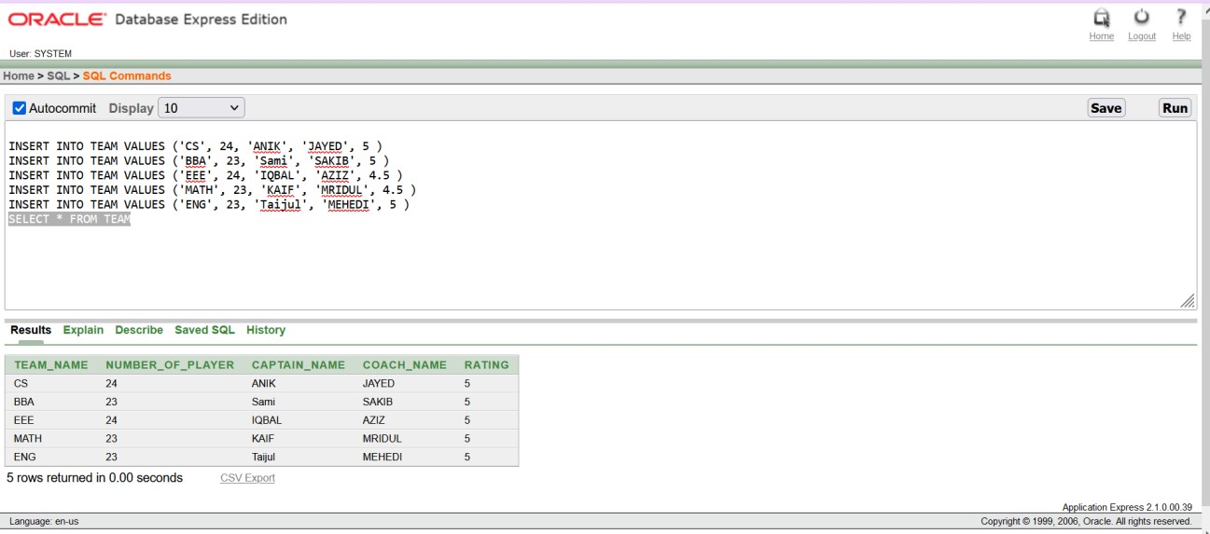
9.
INSERT INTO PLAYER_DOB VALUES(101,'21-01-2002',20)
INSERT INTO PLAYER_DOB VALUES(102,'11-06-2003',19) INSERT INTO PLAYER_DOB VALUES(103,'07-07-2000',22) INSERT INTO PLAYER_DOB VALUES(104,'12-02-2004',18) INSERT INTO PLAYER_DOB VALUES(105,'10-08-1999',23) INSERT INTO PLAYER_DOB VALUES(106,'25-07-1998',24) INSERT INTO PLAYER_DOB VALUES(107,'30-06-1997',25) INSERT INTO PLAYER_DOB VALUES(108,'30-08-2000',22) INSERT INTO PLAYER_DOB VALUES(109,'01-02-2001',21)
Select *from player_dob

Slide 30
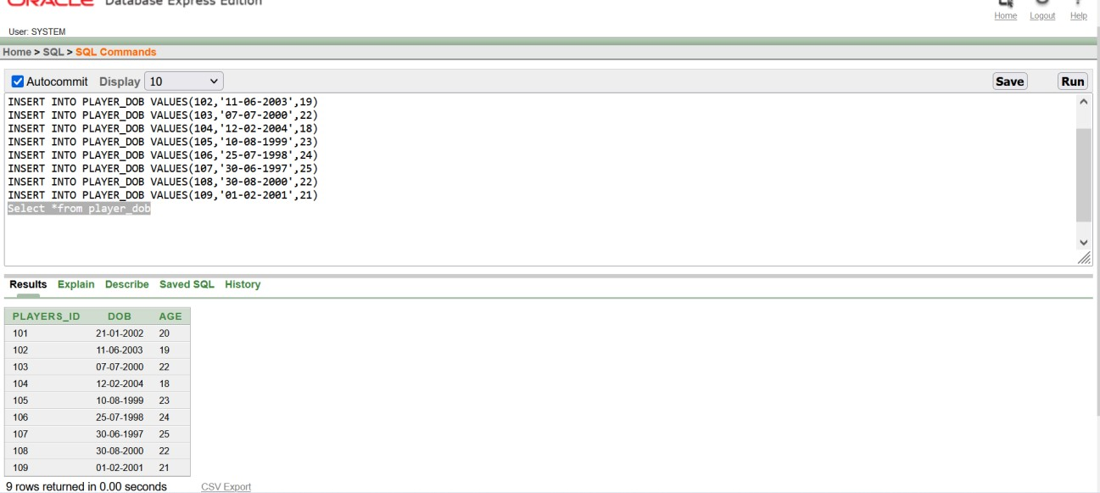
VIEW
1. SIMPLE VIEW:
CREATE VIEW PLAYER_CS
AS SELECT NAME,Attributes,AGE,SAL,RATING,TEAM_NAME FROM PLAYER_INFO WHERE TEAM_NAME=('CS')
SELECT *FROM PLAYER_CS

Slide 31
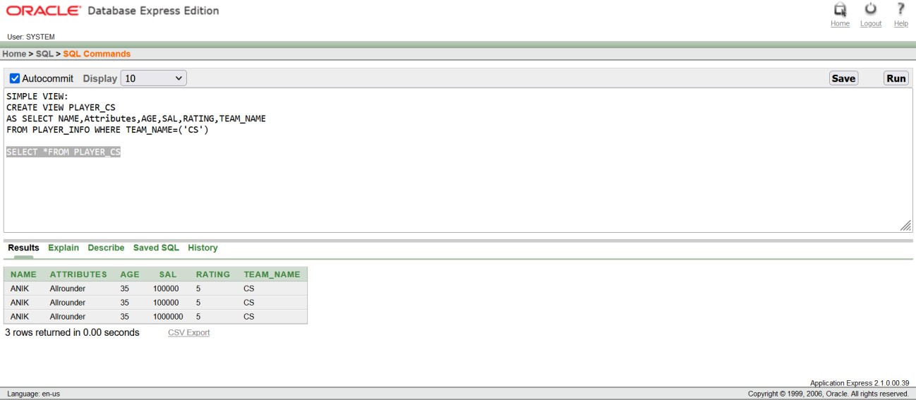
2. COMPLEX VEIW:
CREATE VIEW TEAM_PLAYER AS SELECT
P.NAME,P.Attributes,P.AGE,P.SAL,T.CAPTAIN_NAME,T.COACH_NAME,T.TEAM_NAME
FROM PLAYER_INFO P,TEAM T
WHERE P.TEAM_NAME=T.TEAM_NAME
SELECT *FROM TEAM_PLAYER

Slide 32
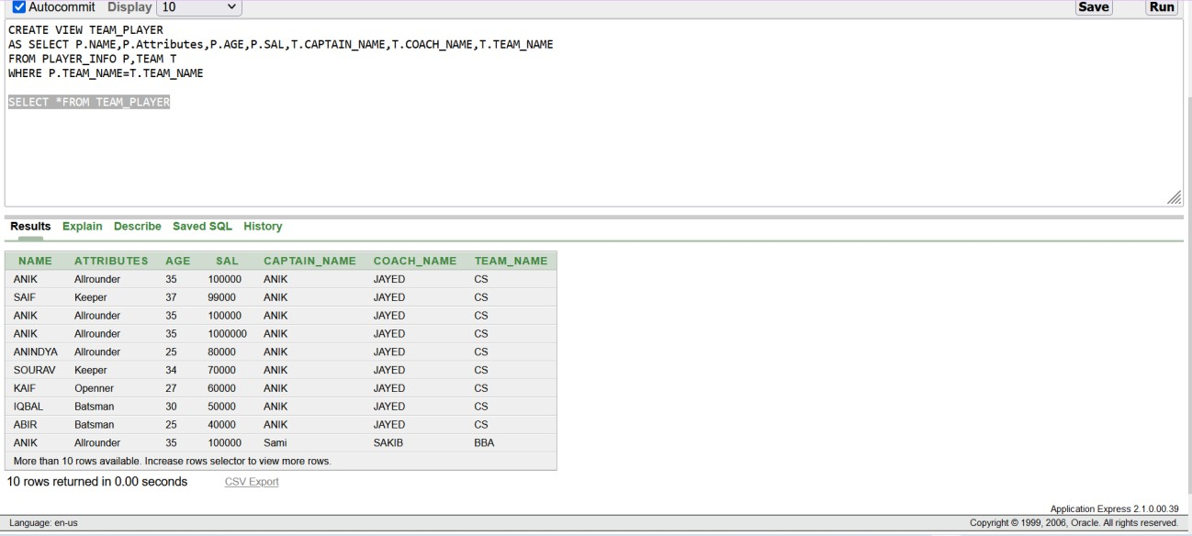
SEQUENCE:
CREATE SEQUENCE PLAYER_id
start with 100
increment by 1
maxvalue 200
nocache nocycle;

Slide 33
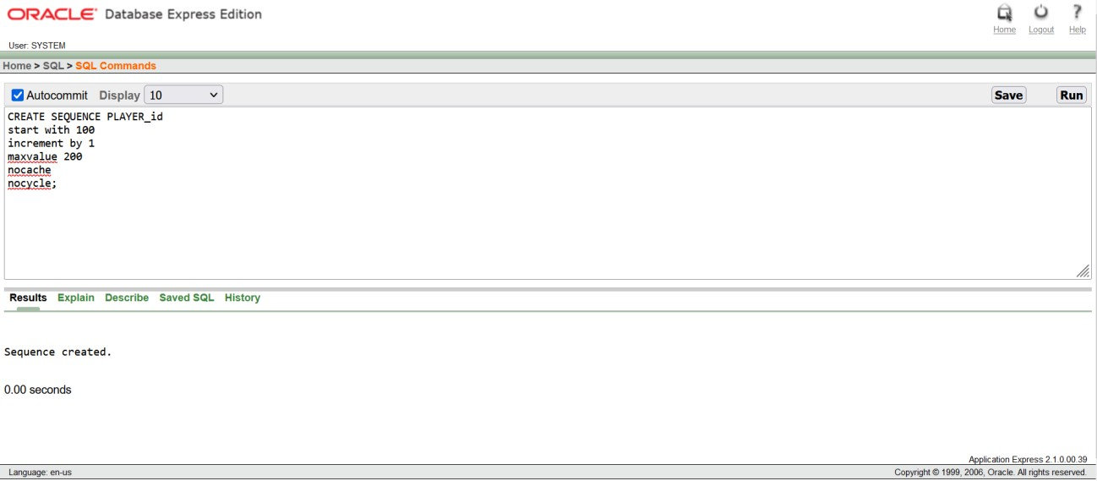
Conclusion
In this final term group project, we have tried to present that how AIUB cricket club management system database can be built. This AIUB cricket club management system is built players who have shortage of runs so easily without getting stress.
With a new user authentication, we have made the table and inserted data on it. Our experience in building this database management was to show the abilities of technology. By using this database on the real-world application, the players can access in the cricket game Furthermore, in future, we will try to develop areal-world application and use this database on the application which will be a very initiative learning for us. When we will use this in the real-world project, we can find out the errors of this database management system and can be able to fix the errors. Finally, it is very clear that, this project will help us in future a lot.

Slide 34
THANK YOU

